Slide 1

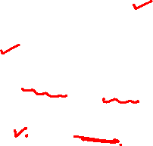
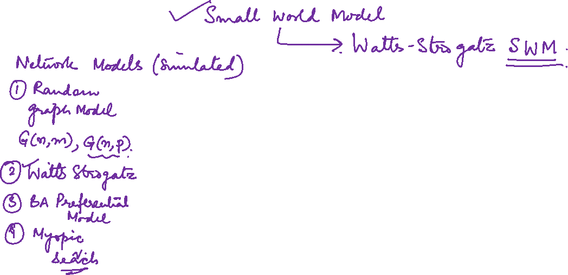
Graph Theory and Its Applications
Watts and Strogatz Small World Model
Dr. Arti Arya
Department of Computer Science
and Engineering

Slide 2

Graph Theory and Its Applications
Watts and Strogatz Small World Model
Dr. Arti Arya
Department of Computer Science and Engineering

Slide 3
Graph Theory and Its Applications Acknowledgement
The course slides are prepared by Prof. BhaskarJyoti. But various additional inputs are added by me from various reliable resources from Foreign and Indian Universities as well as from sites.
Notes:
Ok. Having said that, lets get back to what we were speaking about.
Input devices. We have seen that the virtual reality eco system largely encompasses three fundamental components that include
HMD – head mounted devices that give you immersive VR experience, we saw some examples in the last class like the HTC VIVE, Oculus Rift, Samsung gear and so on. Some of you have also used few of these and experienced it for a few minutes.
And the second components is the GTD or the Gesture Tracking Devices. We saw a video of Xsense IMU sensors that can accurately estimation the position and orientation of a dancer. we will in the next hour see how these gesture tracking devices work and what are the various technicalities that go into tracking. I will try to keep it as non-mathematical as possible, as the mathematics behind it can get pretty messy and complicated. However, if you are interested in the mathematical aspects, I will be more than happy to discuss.
On the screen you can see that a 3 directional coordinate system is depicted. The 3 primary axes of a 3d coordinate system is X, Y and Z axis. Hear I would like to know where, when and why in your past have you encountered 3 dimensional coordinate system.
Give some time to the students to ponder on
Ok, if I tell you, I have encountered 2 dimension in images, drawings, sketch and so on. While I have encountered 1 dimension when I want to know the temperature currently or current time or something like that. Similar, where and when have you encountered 3D, either consciously or subconsciously.
Explain the roll pitch and yaw concepts.
Degree of freedom

Slide 4
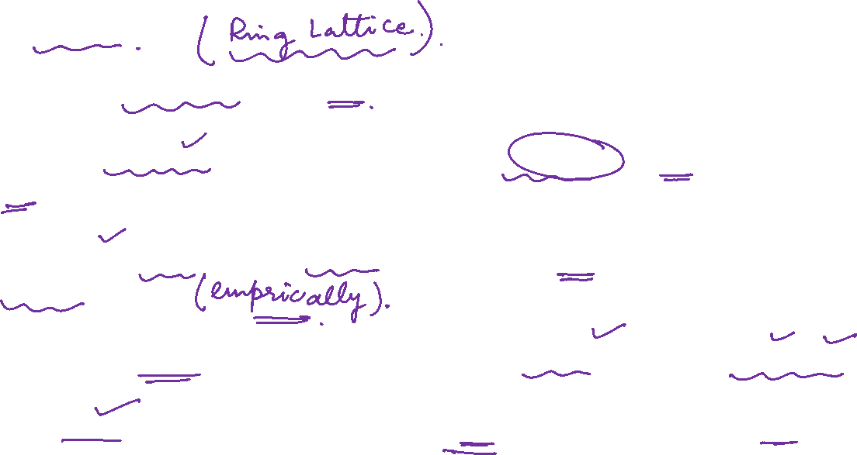
Graph Theory and Its Applications
Small World Model
Friendships are not random in real world.
Unlike Random graph model, one can assume egalitarian model in real world n/ws( people having same no. of neighbors.)
Kind of unrealistic but models/captures clustering coeff of real world n/ws more accurately.
In terms of graph theory, it is equivalent to embed individuals in a regular network.
A regular (ring) lattice is a special case of regular networks where there exists a certain pattern for how ordered nodes are connected to one another.

Slide 5
NETWORK ANALYSIS AND MINING
Basic assumption
In real world, many individuals have limited /fixed connection and they don’t randomly connect with others ! But in real world, most people have a similar fixed set of connections ( parents, siblings, teachers , students etc.)
So, an egalitarian assumption (all are equal) : all have same number of connections !
Unrealistic assumption but probably helps simulate the clustering coefficient of real life network better !
In graph theory it means embedding individuals in regular network
A regular (ring) lattice is a special case of regular networks where there exists a certain pattern for how ordered nodes are connected to one another.

Slide 6
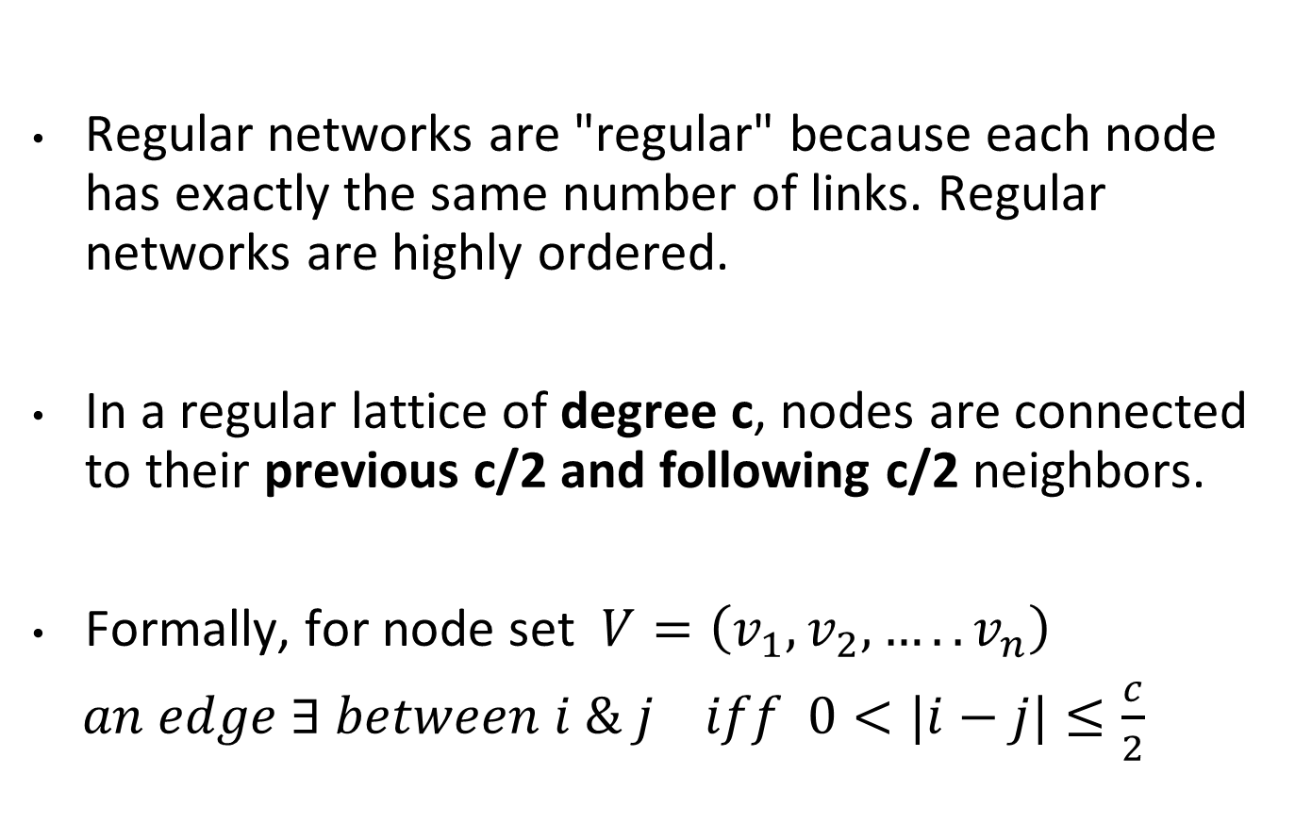
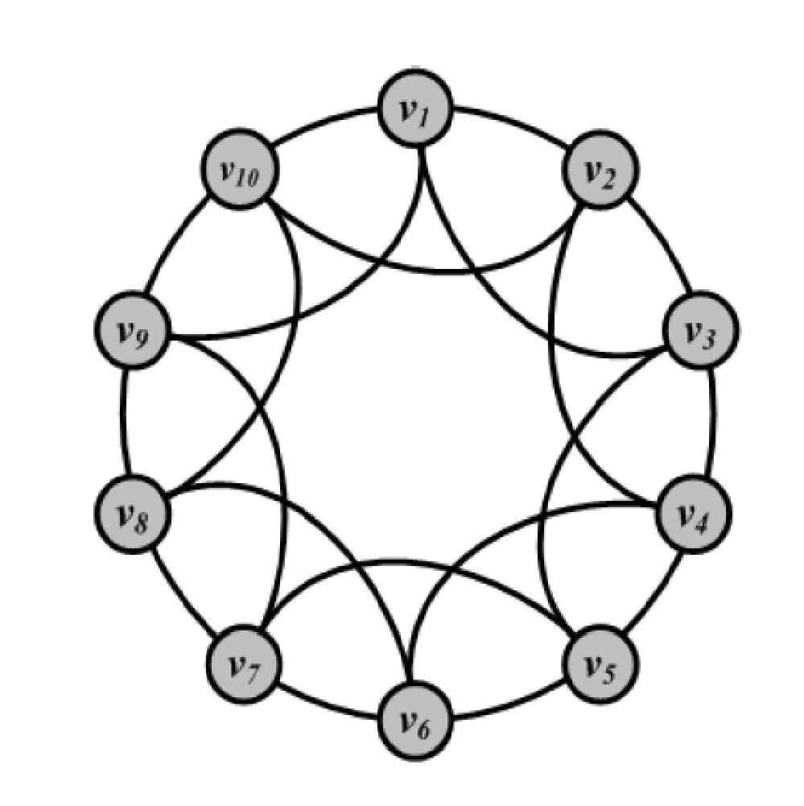
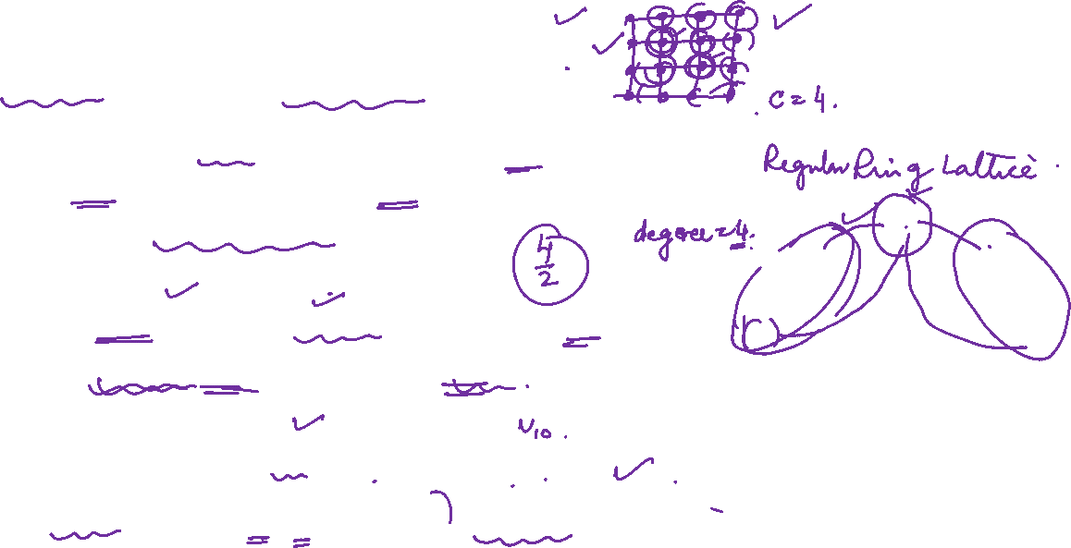
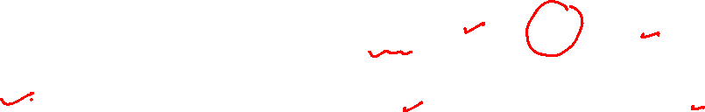
Graph Theory and Its Applications
Proximity modelled in a regular lattice

Slide 7
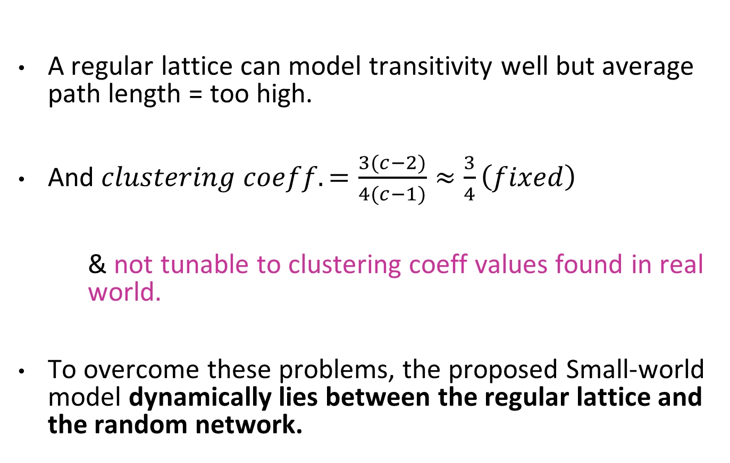
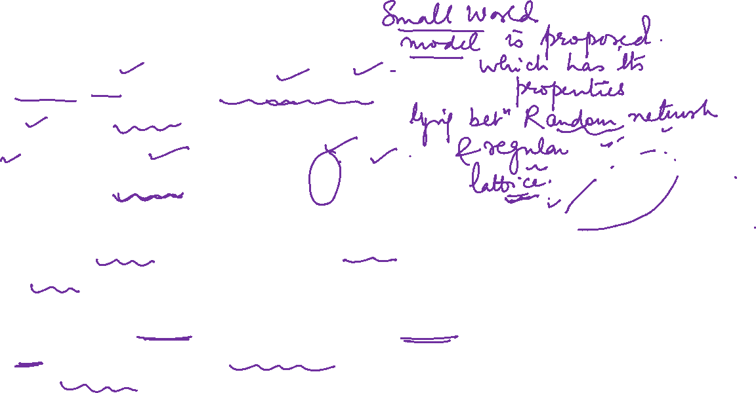
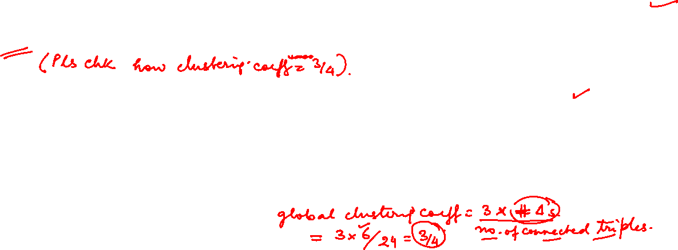
Graph Theory and Its Applications
Proximity modelled in a regular lattice

Slide 8
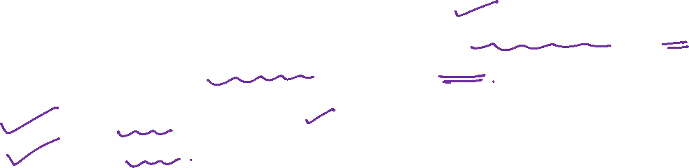
Graph Theory and Its Applications
Small World Model
Small-world Model also known as the Watts and Strogatz model is a special type of random graphs with small-world properties, including:
Short average path length
High clustering.
It was proposed by Duncan J. Watts and Steven Strogatz in their joint 1998 Nature paper

Slide 9
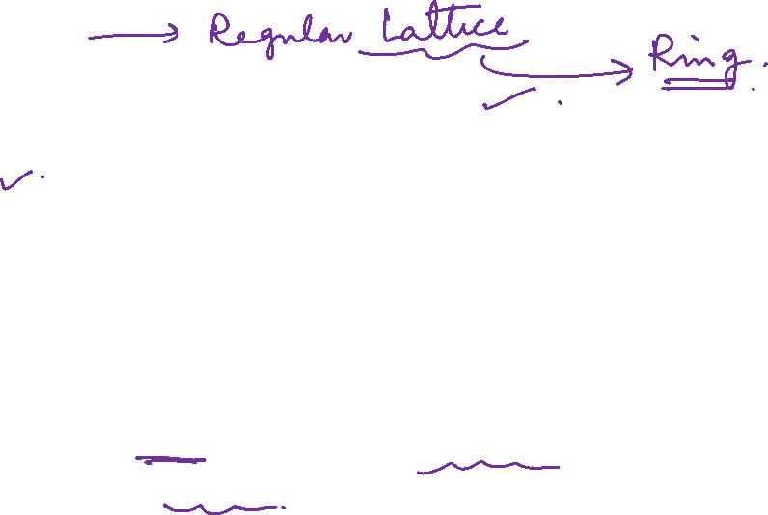
Graph Theory and Its Applications
Small World Model
The small-world model posits a network built on a low-dimensional regular lattice (capturing geographic or other type of social proximity),
and then adding or moving random edges to create a low density of “shortcuts” that join the remote parts of the lattice to one another.
The best studied case is a one-dimensional lattice with periodic boundary conditions, i.e., a ring.

Slide 10
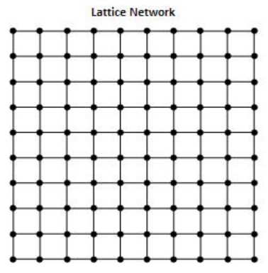
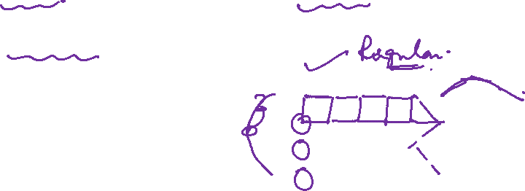
Graph Theory and Its Applications
More about Regular Lattice: Regular low dimensional square lattice(FYI)
A square "regular" lattice is a non-random regular network where each node connects to all of its nearest neighbors.
Lattices can also be represented as rings, trees, and stars.
The lattice can characterize swarms, schools, herds, and flocks where the behavior of each individual (node) depends upon the behavior of its nearest neighbors.
In the lattice network shown, the topological rule is that each node is linked to all of its four nearest neighbors.
No statistical rule is needed to define the lattice's degree distribution because the number of degrees 4 is the same for each node.

Slide 11
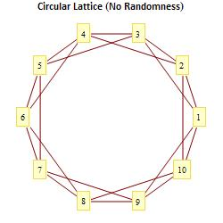
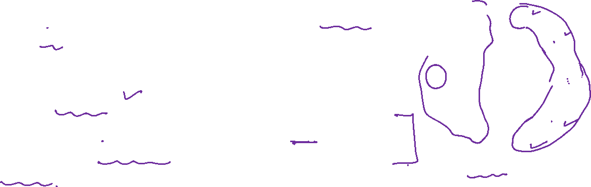
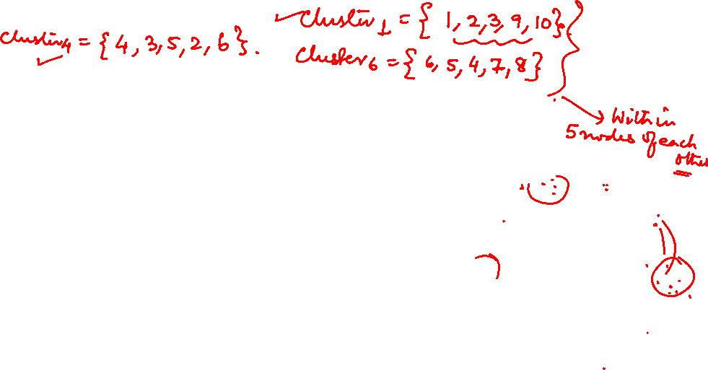
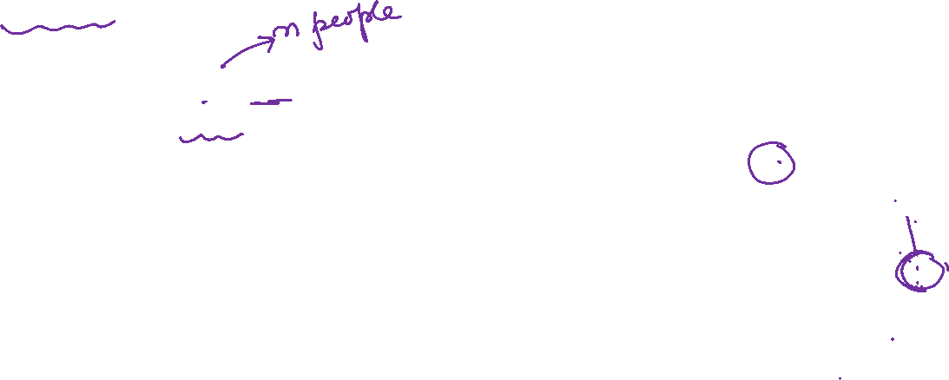
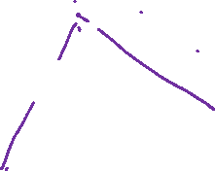
Graph Theory and Its Applications
Regular ring lattice
Consider a ring with n nodes and join each node to its neighbors k or fewer hops (lattice spacings) away.
Each node is "clustered" (connected) to four nearest neighbor nodes.
For example, nodes 1,2,3,10, and 9 form a cluster because 2,3,10, and 9 all connect to node #1.
Here # of hops = 2
The circular form makes it easy to demonstrate the effects of short path lengths and clustering on connectivity.
A ring lattice with degree 4

Slide 12
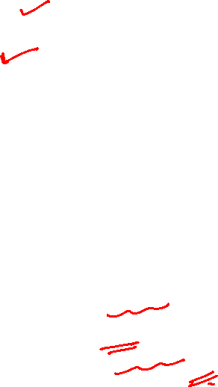
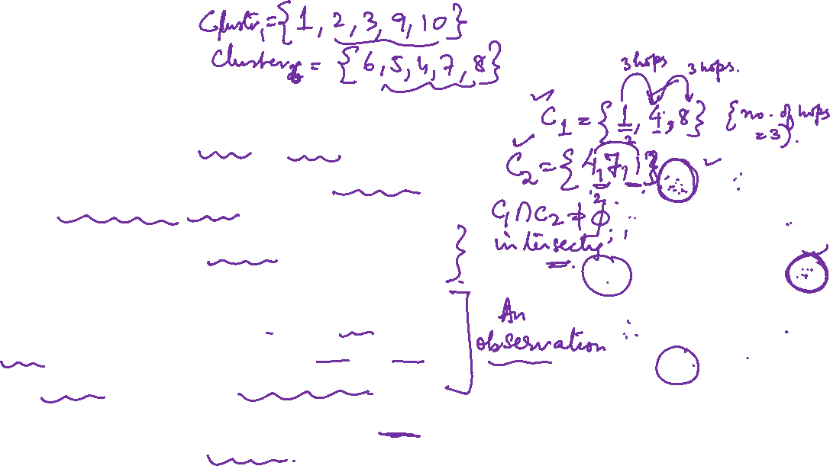
Graph Theory and Its Applications
Regular ring lattice
Two nodes placed on opposite sides of the circle lattice (see nodes #1 and #6 which are remote nodes) are members of separate clusters that do not intersect.
There are relatively long path lengths (low connectivity) between these remote nodes.
Two nodes that are within three nodes of each other on the circle (nodes #1 and #4) belong to separate but intersecting clusters.
This kind of intersecting clustering enhances connectivity within the network.
Node #1 and 4 is equivalent to two groups of friends where some people belong to both groups.

Slide 13
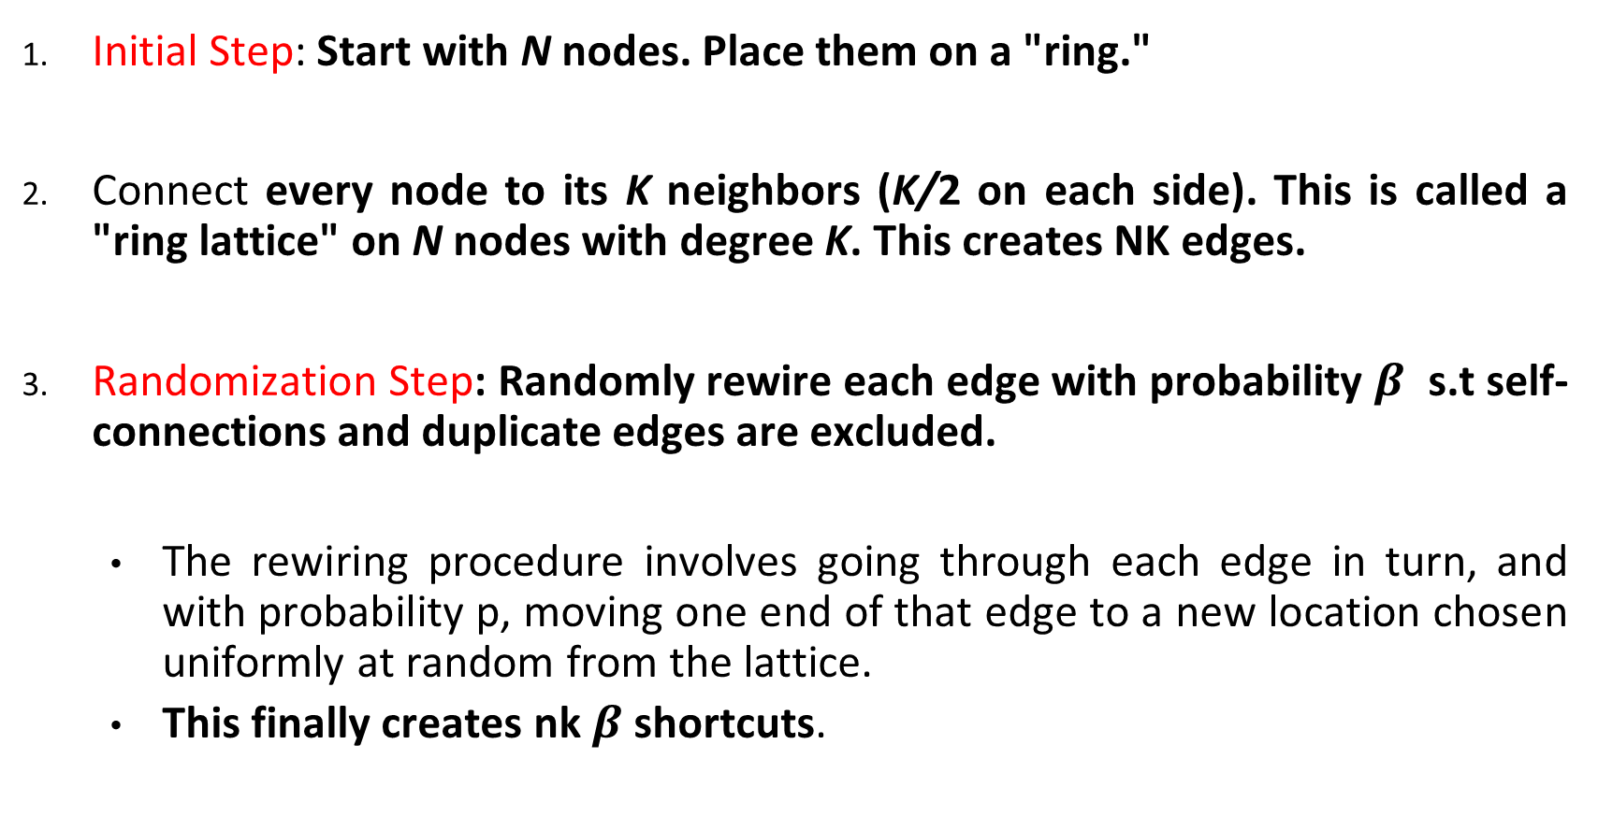
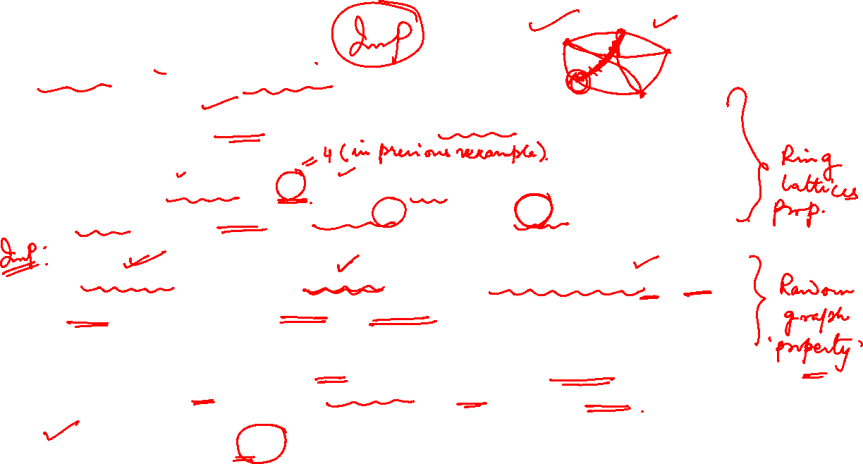
Graph Theory and Its Applications
Watts –Strogatz Small World Model : steps

Slide 14
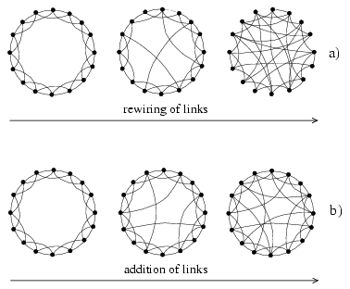
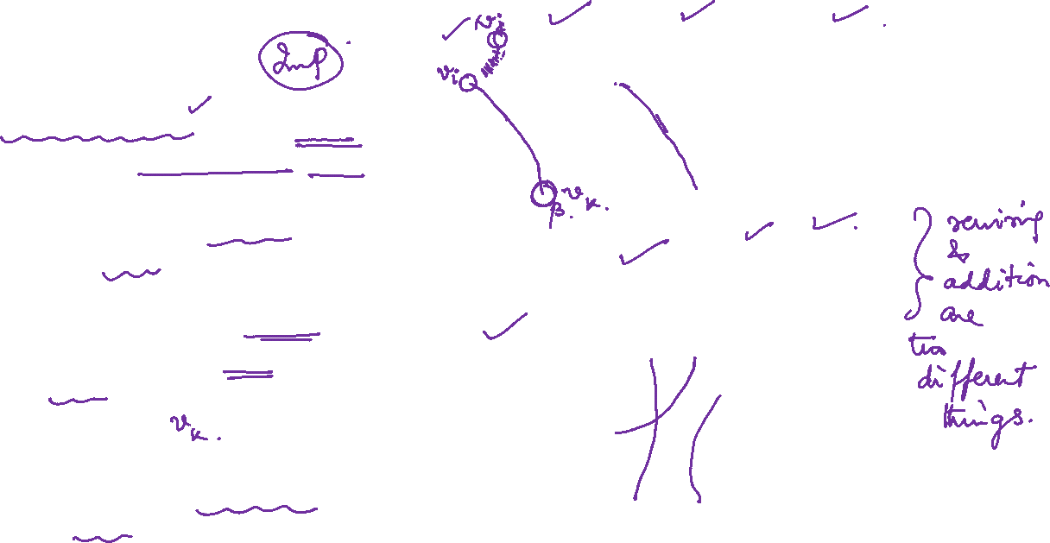
Graph Theory and Its Applications
Rewiring of the links
Rewiring replaces an existing edge between nodes v_{i} and v_{j} with a non-existing edge between two nodes with probability β.
In other words, an edge is disconnected from one of its endpoints and connected to a new endpoint.
New end point is selected uniformly.

Slide 15
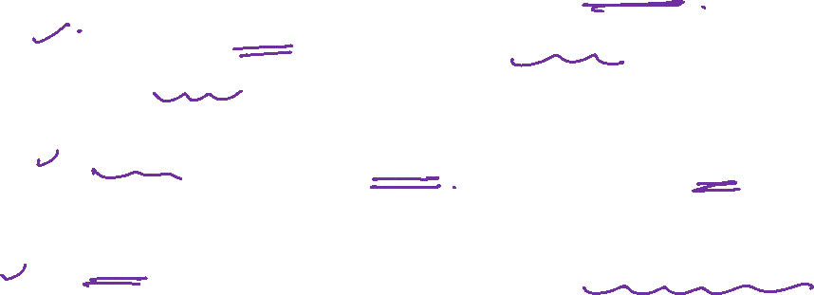
Graph Theory and Its Applications
Parameters of Watts Strogatz Small-World Model
There are three parameters to the Watts-Strogatz model.
N is the number of nodes in the graph to be simulated.
K is the degree of each node at the initial step of the algorithm.
3. β is the probability of randomly rewiring each edge in the second step of the algorithm.

Slide 16
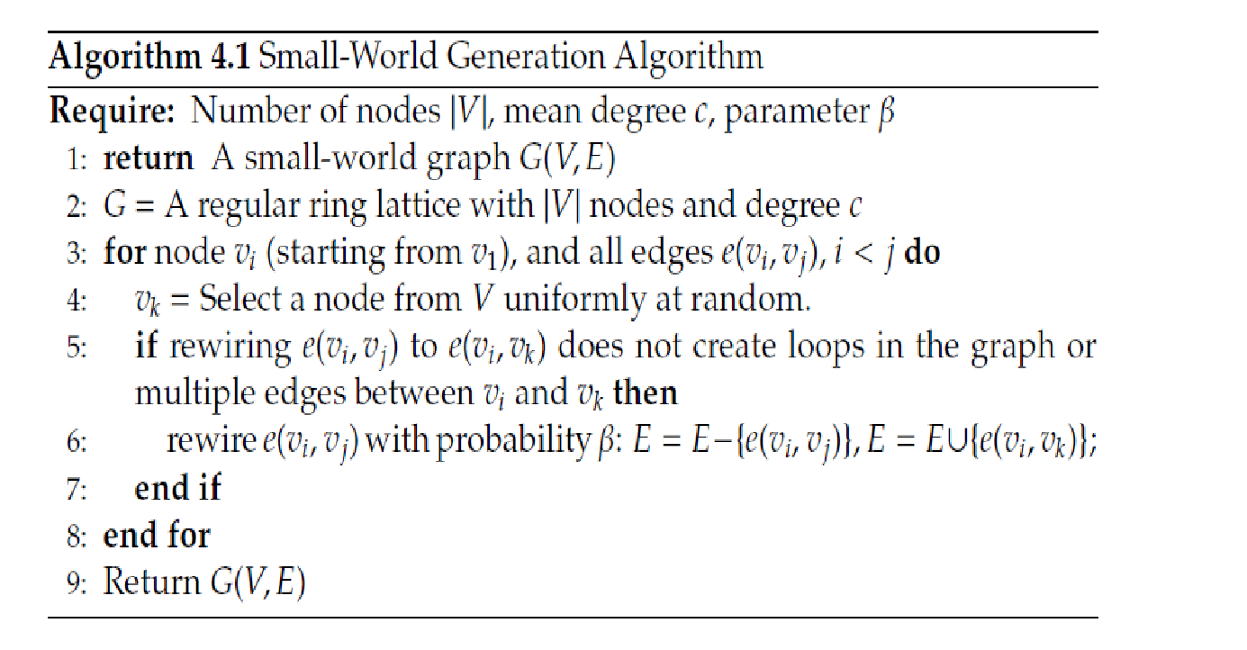
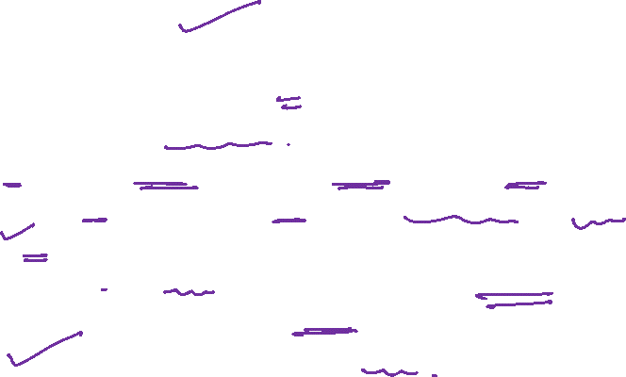
Graph Theory and Its Applications
The algorithm

Slide 17
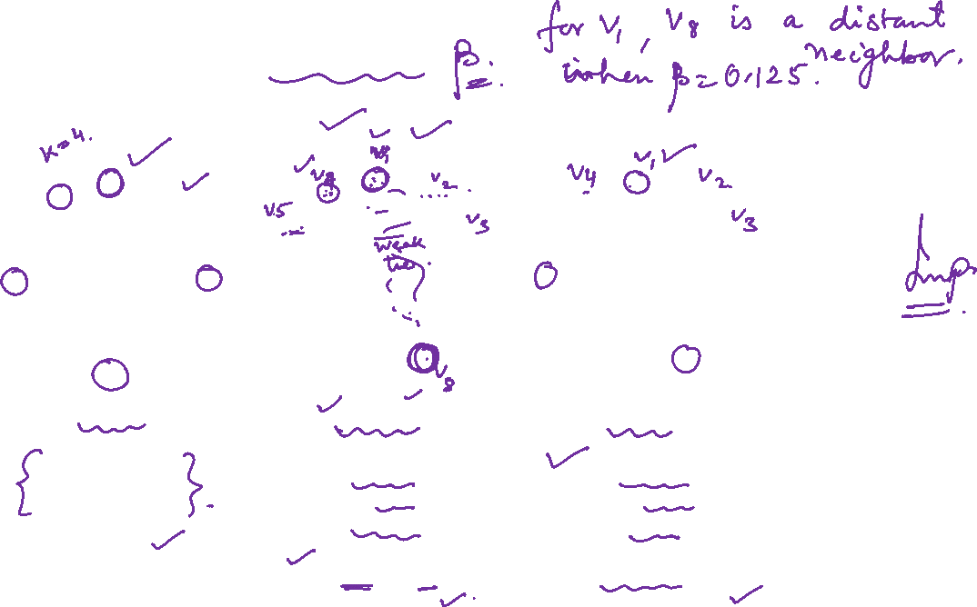
Graph Theory and Its Applications
Interpretation of parameter beta
β = 0
β = 0.125
β = 1
People know
their neighbors.
Clustered, but
not a “small world”
People know
their neighbors,
and a few distant people.
Clustered and
“small world”
People know
others at
random.
Not clustered,
but “small world”

Slide 18
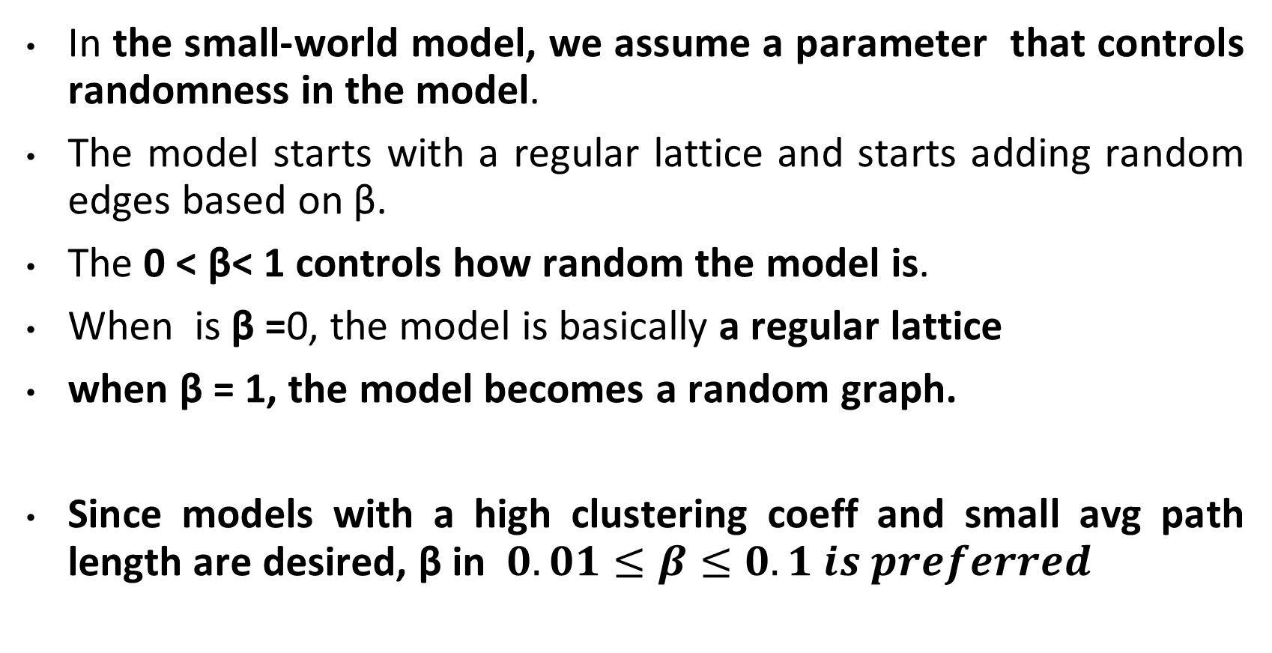

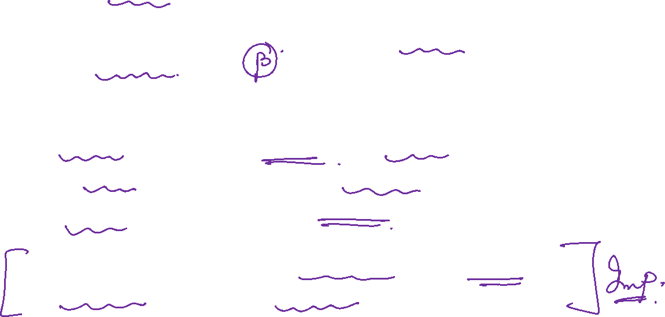
Graph Theory and Its Applications
Randomness in the model

Slide 19
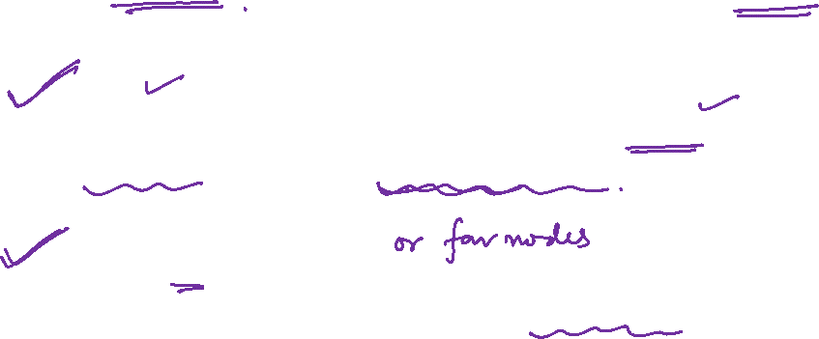
Graph Theory and Its Applications
Homophily and weak ties come back !
Small World model follows two basic social-network concepts:
Homophily: the principle that we connect to others who are like ourselves, and hence creates many triangles.
Weak ties: the links to acquaintances that connect us to parts of the network that would otherwise be far away, and hence the kind of widely branching structure that reaches many nodes in a few steps.

Slide 20
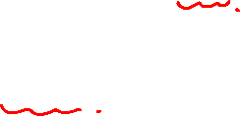
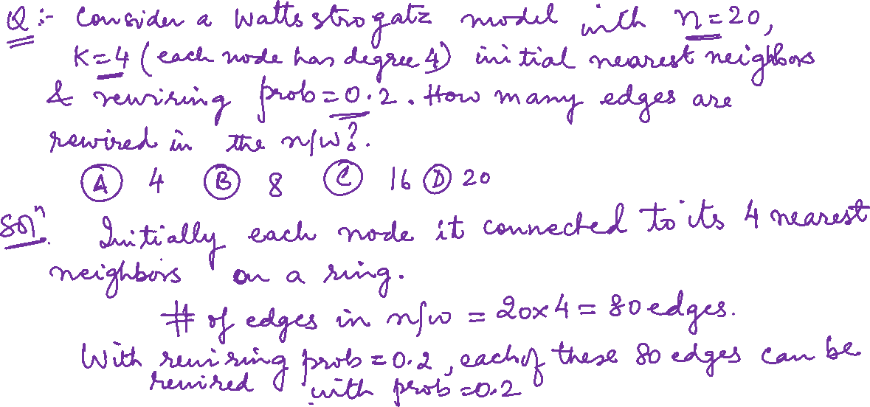
Graph Theory and Its Applications
A problem on Rewiring of links

Slide 21
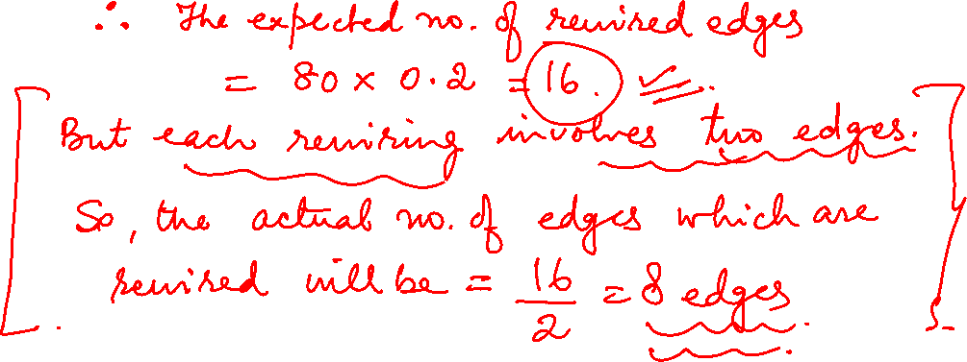

Slide 22
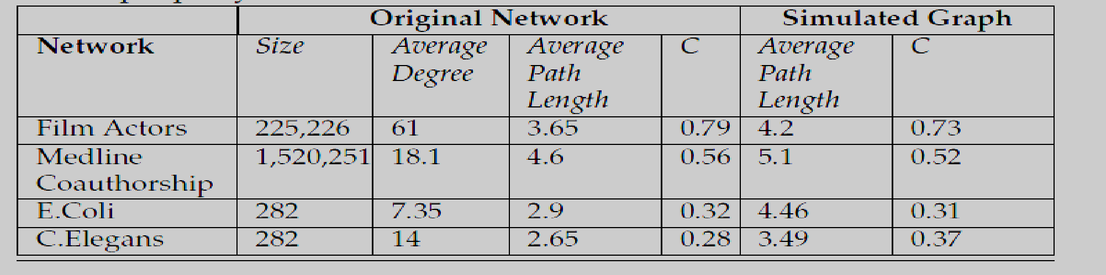

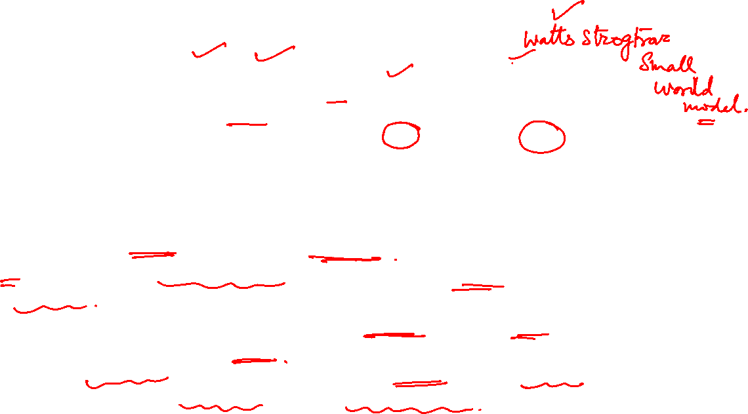
NETWORK ANALYSIS AND MINING
Real world network and simulated graph
A desirable model for a real-world network should generate graphs with high clustering coefficients and short average path lengths.
In the simulated network, the average path length is small and the clustering coefficient is high ( as expected).
However small-world model is incapable of generating a realistic degree distribution (power law) in the simulated graph

Slide 23
THANK YOU
Dr. Arti Arya
Department of Computer Science and Engineering

